Slide 1
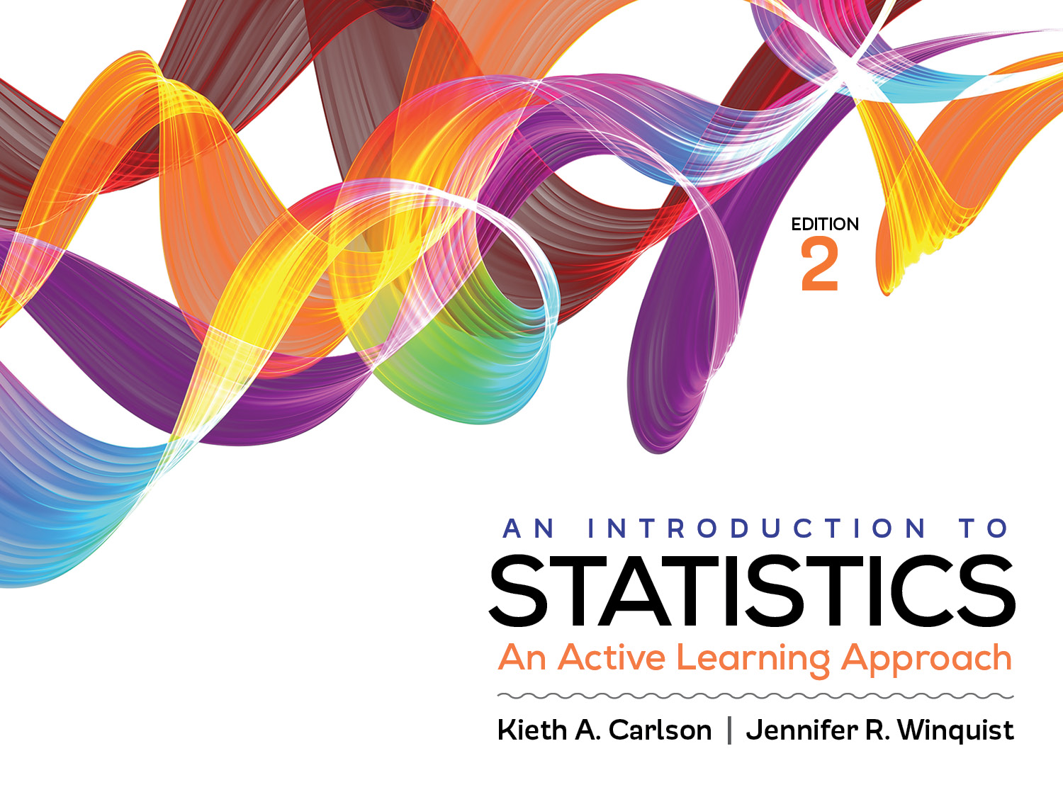
Introduction to Activity 1.1

Slide 2
Chapter 1 Reading Questions (RQs)
Reading the chapters and doing RQs prepare you for the day’s activity.
If you do not read the chapters or understand the RQs you will struggle with the day’s activity
You have to prepare for each day of class.
Do you have questions on anything in the reading?

Slide 3
Activity 1.1 will require you to:
Use the Statistical Package for the Social Sciences (SPSS)
Identify scales of measurement
Identify continuous and discrete variables
Interpret and create frequency distributions (tables and graphs)

Slide 4
Statistical Package for the Social Sciences (SPSS)
About half of the activities (assignments) in this class require you to use SPSS.
It is worth learning to use it for this class, other classes, and several careers
Opening files
Open SPSS first, then go to blackboard and open file in “data files”
Running analyses

Slide 5
Scales of Measurement
Nominal
Categories represent different kinds of things
Categories do NOT have an order of more or less
What is an example?
Ordinal
Levels represent different amounts of things, but they can NOT quantify “how much more” one level has than another level.
What is an example?
Interval/Ratio
Values represent different amounts of things, and they DO quantify “how much more” one value is than another value.
What is an example?

Slide 6
Scales of measurement practice
Are each of the following Nominal, Ordinal, or Interval/Ratio?
Heart rate (measured by beats per minute)
Marital status (e.g., single, divorced, married, etc…)
Household Income level (e.g., lower, middle, and upper)
Household gross income in dollars
Body temperature in degrees Fahrenheit
Place in a race (e.g., 1st, 2nd, etc.)
Notes:
Answers to questions: Heart rate = ratio; marital status = nominal; household income level = ordinal; household income in dollars = interval;
body temperature in F = interval; place in a race = ordinal

Slide 7
Continuous/Discrete Practice
Continuous variables: fractions of units make sense
Discrete variables: fractions of units do NOT make sense
Are each of the following variables continuous or discrete?
Systolic blood pressure
Number of students in a class
Height measured in inches
Body temperature in degrees Fahrenheit
Notes:
Systolic blood pressure = continuous
Number of students in a class = discrete
Height measured in inches = continuous
Body temperature in degrees Fahrenheit = continuous

Slide 8
Frequency Distribution Graphs
For continuous data use histogram or line graph
For discrete data use bar graph
Graph shapes
Normal—are symmetrical; values “pile up” in center
Positively skewed—longer tail “points” to the right (i.e., positive values)
Negatively skewed—longer tail “points” to the left (i.e., negative values)
Platykurtic—flatter “pile” than normal distribution
Leptokurtic—taller “pile” than normal distribution
Draw an example of each of these shapes; compare them to those drawn by others.

Slide 9
Examples: Frequency Table & Bar Graph
# of siblings (X) | How many gave this response (f)
0 | 2
1 | 4
2 | 5
3 | 2
4 | 1
How many responded?
How many gave 1 as their response?
How many have more than 2 siblings?
What percentage of respondents have at least 2 siblings?
Notes:
How many responded? 14
How many gave 1 as their response? 4
How many have more than 2 siblings? 3
What percentage of respondents have at least 2 siblings? 8/14 = 57.1%

Slide 10
How to work on Activities in this course
All the activities have new information that was not in the chapter, so be sure to read carefully.
Work with others; talk about your answers—explain why they are correct to each other.
Do not rush! It is ok if you do not finish in class
Your goal is understanding, you won’t necessarily get the answers right the first time and that is ok
The answers are on Blackboard; check your work but DO NOT just copy answers
The activity should be completed before the next class
If you finish early
Take the chapter 1 practice quiz on Blackboard (required)
Take the scales of measurement practice quiz on Blackboard (not required)
Read chapter 2 and answer the reading questions
Figure out the statistics mode on your calculator
Watch videos on scales of measurement (only if you have headphones)

